Slide 1
RANGE & QUARTILE DEVIATION

Slide 2
Range
Range is defined as the difference between two extreme values that is the largest and the smallest value in a distribution. Higher value of range implies higher dispersion and vice versa. It is an absolute measure of dispersion and is computed on the basis of spread of values.

Slide 3
Coefficient of Range
It is a relative measure of dispersion. It is used to compare variation of two series expressed in different units. Generally, it is defined as the ratio of difference between the largest value(L) and the smallest value(S) to their sum.

Slide 4
Calculation of range and its Coefficient for different statistical series
Calculation of range and its Coefficient is discussed with respect to individual, discrete and continuous series.
These are as follows:
In individual series To calculate range and its coefficient, locate the largest and the smallest value of the series.
Computer range with the help of following formula
Range(R) = largest value(L) - Smallest value(S)
Compute coefficient of range with the help of following formula
Coefficient of Range = L-S/L+S

Slide 5
In discrete series The steps for computation of range and its Coefficient are the same as discussed in the case of individual series. Frequencies corresponding to different values are not considered while computing range of the discrete series.

Slide 6
In continuous series Check is the given series an exclusive distribution or not. If not, then it should be first converted into an exclusive distribution.
Calculate range with the help of given formula
Range = Upper limit of the highest class interval(L) - Lower limit of the highest class interval(S)
Calculate coefficient of range with the help of following formula
Coefficient of range = L-S/L+S

Slide 7
Inter-quartile range and Quartile deviation
Inter-quartile range and Quartile deviation and its Coefficient are also computer on the basis of spread of values. These measures of dispersion are completed with the help of quartiles.
These measures are explain below
Interquartile range It is the difference between upper quartile and lower quartile. Thus,
Inter-quartile range (IQR) = Upper Quartile(Q₃) – Lower Quartile(Q₁)
It is based upon middle 50% of the value of a distribution and therefore, it is not affected by Extreme values. It is an absolute measure of dispersion.

Slide 8
Quartile deviation It is half the difference of upper quartile and lower quartile that is half of interquartile range. It is also known as semi-inter-quartile range and denoted by QD. It is an absolute measure of dispersion.
Thus, QD = $\frac{Q_{3− }Q_{1}}{2}$
where, Q3 is equal to upper quartile and Q1 is equal to lower quartile

Slide 9
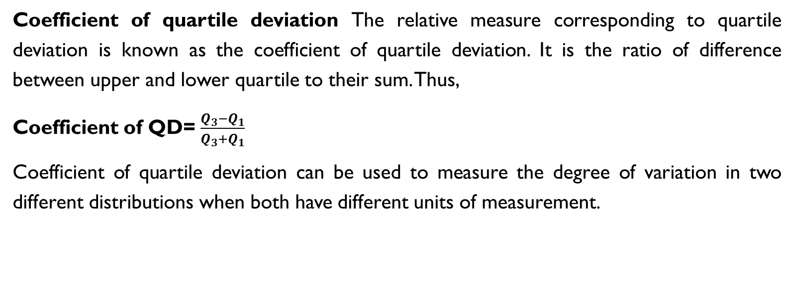
Coefficient of quartile deviation The relative measure corresponding to quartile deviation is known as the coefficient of quartile deviation. It is the ratio of difference between upper and lower quartile to their sum. Thus,
Coefficient of QD= $\frac{Q_{3}−Q_{1}}{Q_{3}+Q_{1}}$
Coefficient of quartile deviation can be used to measure the degree of variation in two different distributions when both have different units of measurement.

